Slide 1
Chapter 4 – Requirements Engineering

Slide 2
Topics covered
User and System requirements
Functional and non-functional requirements
Requirements engineering processes

Slide 3
Requirements engineering
The process of establishing the services that a customer requires from a system and the constraints under which it operates and is developed is called Requirements engineering.
Requirement may range from a high-level abstract statement of a service or of a system constraint to a detailed mathematical functional specification.

Slide 4
Types of requirement
User requirements
System requirements

Slide 5
User and system requirements

Slide 6
System stakeholders
Any person or organization who is affected by the system in some way and so who has a legitimate interest
Stakeholder types
End users
System managers
System owners
External stakeholders

Slide 7
Stakeholders in the Mentcare system
Patients whose information is recorded in the system.
Doctors who are responsible for assessing and treating patients.
Nurses who coordinate the consultations with doctors and administer some treatments.
Medical receptionists who manage patients’ appointments.
IT staff who are responsible for installing and maintaining the system.

Slide 8
Functional requirements
Describe functionality or system services.
Depend on the type of software, expected users and the type of system where the software is used.
Functional user requirements may be high-level statements of what the system should do.
Functional system requirements should describe the system services in detail.

Slide 9
Mentcare system: functional requirements
A user shall be able to search the appointments lists for all clinics.
The system shall generate each day, for each clinic, a list of patients who are expected to attend appointments that day.
Each staff member using the system shall be uniquely identified by his or her 8-digit employee number.

Slide 10
Requirements imprecision
Problems arise when functional requirements are not precisely stated.
Ambiguous requirements may be interpreted in different ways by developers and users.
Consider the term ‘search’ in requirement 1
User intention – search for a patient name across all appointments in all clinics;
Developer interpretation – search for a patient name in an individual clinic. User chooses clinic then search.

Slide 11
Requirements completeness and consistency
In principle, requirements should be both complete and consistent.
Complete
They should include descriptions of all facilities required.
Consistent
There should be no conflicts or contradictions in the descriptions of the system facilities.
In practice, because of system and environmental complexity, it is impossible to produce a complete and consistent requirements document.

Slide 12
Non-functional requirements
These define system properties and constraints e.g. reliability, response time and storage requirements. Constraints are I/O device capability, system representations, etc.
Process requirements may also be specified mandating a particular IDE, programming language or development method.
Non-functional requirements may be more critical than functional requirements. If these are not met, the system may be useless.

Slide 13
Types of nonfunctional requirement

Slide 14
Non-functional requirements implementation
Non-functional requirements may affect the overall architecture of a system rather than the individual components.
A single non-functional requirement, such as a security requirement, may generate a number of related functional requirements that define system services that are required.

Slide 15
Examples of nonfunctional requirements in the Mentcare system
Product requirement The Mentcare system shall be available to all clinics during normal working hours (Mon–Fri, 0830–17.30). Downtime within normal working hours shall not exceed five seconds in any one day. Organizational requirement Users of the Mentcare system shall authenticate themselves using their health authority identity card. External requirement The system shall implement patient privacy provisions as set out in HStan-03-2006-priv.

Slide 16
Goals and requirements
Non-functional requirements may be very difficult to state precisely and imprecise requirements may be difficult to verify.
Goal
A general intention of the user such as ease of use.
Verifiable non-functional requirement
A statement using some measure that can be objectively tested.
Goals are helpful to developers as they convey the intentions of the system users.

Slide 17
Usability requirements
The system should be easy to use by medical staff and should be organized in such a way that user errors are minimized. (Goal)
Medical staff shall be able to use all the system functions after four hours of training. After this training, the average number of errors made by experienced users shall not exceed two per hour of system use. (Testable non-functional requirement)

Slide 18
Metrics for specifying nonfunctional requirements
Property | Measure
Speed | Processed transactions/second User/event response time Screen refresh time
Size | Mbytes Number of ROM chips
Ease of use | Training time Number of help frames
Reliability | Mean time to failure Probability of unavailability Rate of failure occurrence Availability
Robustness | Time to restart after failure Percentage of events causing failure Probability of data corruption on failure
Portability | Percentage of target dependent statements Number of target systems

Slide 19
Requirements engineering processes
The processes used for RE vary widely depending on the application domain, the people involved and the organisation developing the requirements.
However, there are a number of generic activities common to all processes
Requirements elicitation;
Requirements analysis;
Requirements validation;
Requirements management.

Slide 20
Requirements elicitation and analysis
Sometimes called requirements elicitation or requirements discovery.
Involves technical staff working with customers to find out about the application domain, the services that the system should provide and the system’s operational constraints.
May involve end-users, managers, engineers involved in maintenance, domain experts, trade unions, etc. These are called stakeholders.

Slide 21
Problems of requirements elicitation
Stakeholders don’t know what they really want.
Stakeholders express requirements in their own terms.
Different stakeholders may have conflicting requirements.
Organisational and political factors may influence the system requirements.
The requirements change during the analysis process. New stakeholders may emerge and the business environment may change.

Slide 22
The requirements elicitation and analysis process

Slide 23
Natural language specification
Requirements are written as natural language sentences supplemented by diagrams and tables.
Used for writing requirements because it is expressive, intuitive and universal. This means that the requirements can be understood by users and customers.

Slide 24
Guidelines for writing requirements
Invent a standard format and use it for all requirements.
Use language in a consistent way. Use shall for mandatory requirements, should for desirable requirements.
Use text highlighting to identify key parts of the requirement.
Avoid the use of computer jargon.
Include an explanation (rationale) of why a requirement is necessary.

Slide 25
Problems with natural language
Lack of clarity
Precision is difficult without making the document difficult to read.
Requirements confusion
Functional and non-functional requirements tend to be mixed-up.
Requirements amalgamation
Several different requirements may be expressed together.

Slide 26
Example requirements for the insulin pump software system
3.2 The system shall measure the blood sugar and deliver insulin, if required, every 10 minutes. (Changes in blood sugar are relatively slow so more frequent measurement is unnecessary; less frequent measurement could lead to unnecessarily high sugar levels.) 3.6 The system shall run a self-test routine every minute with the conditions to be tested and the associated actions defined in Table 1. (A self-test routine can discover hardware and software problems and alert the user to the fact the normal operation may be impossible.)

Slide 27
Structured specifications
An approach to writing requirements where the freedom of the requirements writer is limited and requirements are written in a standard way.
This works well for some types of requirements e.g. requirements for embedded control system but is sometimes too rigid for writing business system requirements.

Slide 28
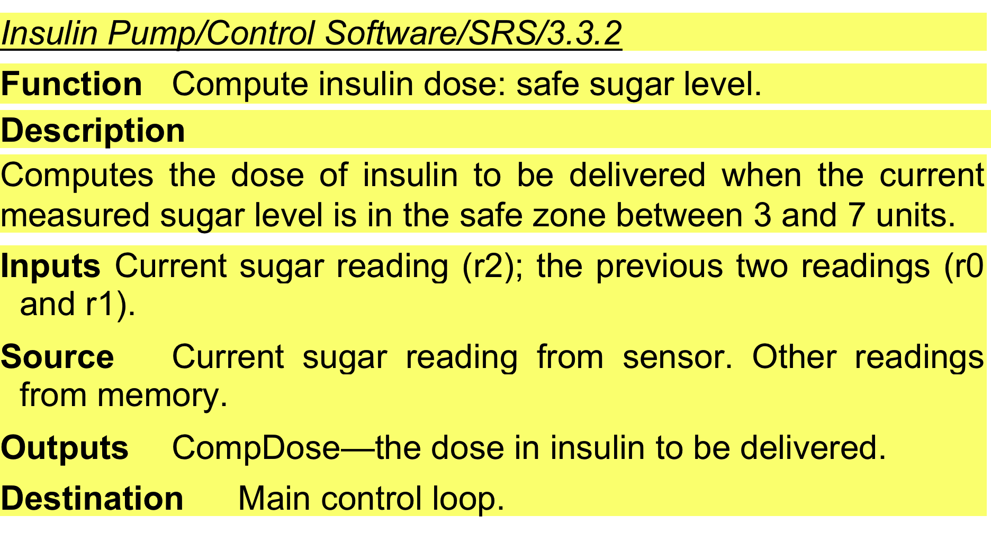
A structured specification of a requirement for an insulin pump

Slide 29
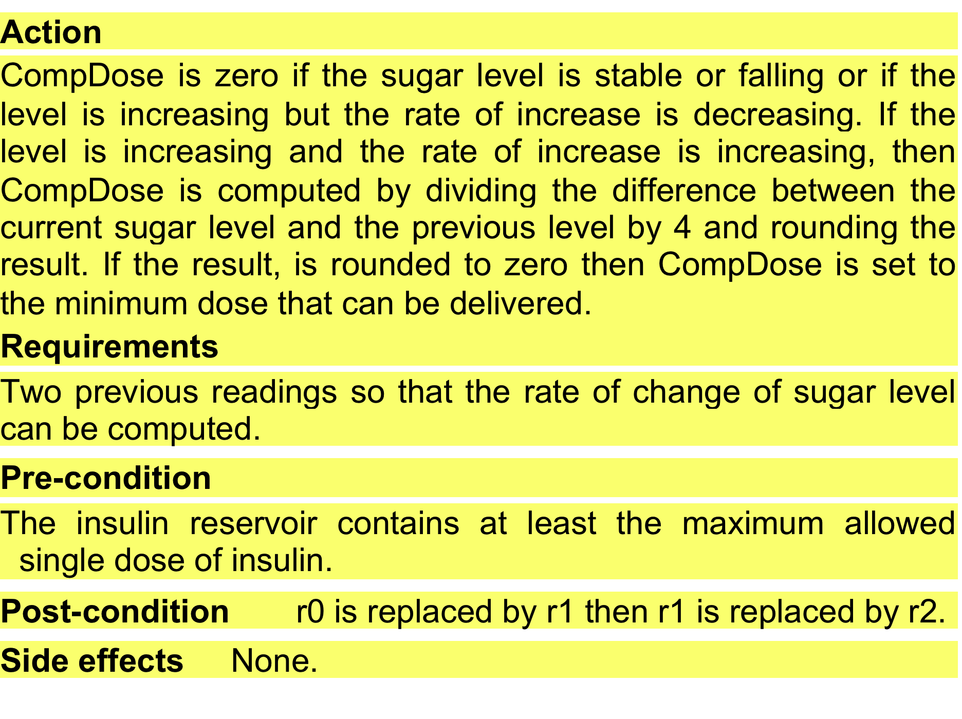
A structured specification of a requirement for an insulin pump

Slide 30
Tabular specification of computation for an insulin pump
Condition | Action
Sugar level falling (r2 < r1) | CompDose = 0
Sugar level stable (r2 = r1) | CompDose = 0
Sugar level increasing and rate of increase decreasing ((r2 – r1) < (r1 – r0)) | CompDose = 0
Sugar level increasing and rate of increase stable or increasing ((r2 – r1) ≥ (r1 – r0)) | CompDose = round ((r2 – r1)/4) If rounded result = 0 then CompDose = MinimumDose

Slide 31
The software requirements document
The software requirements document is the official statement of what is required of the system developers.
Should include both a definition of user requirements and a specification of the system requirements.
It is NOT a design document. As far as possible, it should set of WHAT the system should do rather than HOW it should do it.

Slide 32
Users of a requirements document

Slide 33
Requirements checking
Validity. Does the system provide the functions which best support the customer’s needs?
Consistency. Are there any requirements conflicts?
Completeness. Are all functions required by the customer included?
Realism. Can the requirements be implemented given available budget and technology
Verifiability. Can the requirements be checked?

Slide 34
Requirements management
Requirements management is the process of managing changing requirements during the requirements engineering process and system development.
New requirements emerge as a system is being developed and after it has gone into use.

Slide 35
Requirements management planning
Establishes the level of requirements management detail that is required.
Requirements management decisions:
Requirements identification Each requirement must be uniquely identified so that it can be cross-referenced with other requirements.
A change management process This is the set of activities that assess the impact and cost of changes
Traceability policies These policies define the relationships between each requirement and between the requirements and the system design that should be recorded.
Tool support Tools that may be used range from specialist requirements management systems to spreadsheets and simple database systems.

